Slide 1

ADHYAN
Immersive study solution
Notes:
Watch in presentation mode for maximum Experience

Slide 2
Our Problem Statement
EDUCATION
Creating solutions to deal with these challenges faced by the users:
1. Transforming learning into Amazing e-learning Experiences.
2. Lack Of Learner Motivation And Engagement.
3. Staying Up-To-Date With Modern Tech.
4. Designing e-learning Courses For Different Generations.
5. Measurable learning outcomes.
6. Adaptive learner models to accommodate different learner needs.

Slide 3
Our Solution
Our solution is to use Augmented Reality technology to transform the usual learning experience into an immersive and extremely exciting experience.
We are targeting multiple age groups with different sections in the app. (from teaching about letters to small children to teaching teenagers about the Geography)
Learning via AR is highly interactive and the chance of the learner getting bored is massively reduced when compared to classical teaching methods.
We believe that learning should be a fun journey and not something students dread.

Slide 4


Technologies used
Unity
Blender
ARFoundation
Figma

Slide 5
Our App's USPs
The app uses the dynamic and modern AR technology.
The app provides the signature immersive and interactive experience that comes with AR.
There’s something to learn for every age group.
The app is extremely scalable to accomodate more subjects and topics in the future.

Slide 6
Present day scope
The pandemic has reduced motivation levels of people, especially students, globally. Online classes tend to get boring and with the lockdown slowly lifting, many students are facing difficulties in developing high levels of interest to study.
This is the perfect time for an app like this, because we solve those exact problems - low interest to study and high boredom, by providing a very interesting and immersive learning platform.

Slide 7
Business Model Canvas
Key Feature User Experience Augmented Reality Quiz & News blog
Key Partners Educational Hubs Coaching Institutes Ministry of Human Resource & Development. Newspaper publishers Ministry of Electronics and Information Technology
Value Proposition
Customer Relationships
Customer Segments
Self service
Little personal contact
App based services
For schools and institutions:
Good quality education.
Supplement for classical pedagogical materials.
For learners:
Immersive, engaging & high quality education.
For advertisers:
Specifically targeted so they can have more impact.
Schools and other educational institutions
People who want to learn out of curiosity
Advertisers
Key resources
Creativity
Unity developers
3D artists
Funds
Distribution channel
Channels
Social media
E-mail
Word of mouth
(Queries can also be solved on social media)
Cost Structure:
Developer cost, R&D, Business Development & Operation Costs, maintenance costs.
Revenue Streams:
Subscription Based Model, Freemium model, Revenue from API

Slide 8
Project
Demonstration

Slide 9

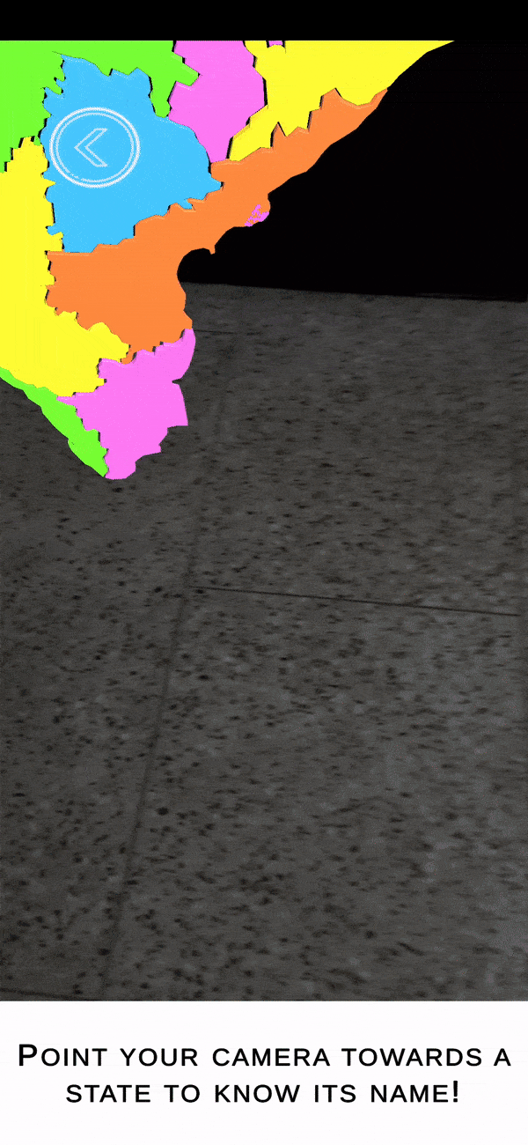
Video Link
Click here
Notes:
Watch in presentation mode

Slide 10
Flow of our Application
START SCENE
(Home page)
CHOOSE YOUR CATEGORY
(Category depends on age group)
CHOOSE TOPIC
(Topic that the user desires to learn is chosen)
AR SCENE
(The camera is launched and the user can place the object in the real world.)
QUIZ SCENE [not yet added] (A mini quiz can be included to test the user’s learning)
EXIT SCENE

Slide 11

App Details
Overview of Idea ​
Through our app, we are aiming to provide fun and interactive education to people of all age groups. The main ideas are - interactivity, immersiveness and affordability.
​
The approach towards Idea Development ​
The pandemic has shown us that everything can be very unpredictable. We wanted to create something that assures the continuity of education regardless of external conditions such as inability to go and learn in a physical classroom.

Slide 12
How do we create an immersiveness and interactive environment?
Augmented Reality (AR) is a type of Immersive Technology where images are presented over the real world. This means that users aren't completely shut off from the world. Instead, AR extends their reality.
So, what the users see on their mobile screens becomes a part of their reality, hence the immersiveness.
Interactivity comes with the ability to move the AR components (3D models and images) which react to touch and can be placed on plane surfaces through the phone’s camera.
AR has the ability to invoke emotions in the user. This combination of interactivity and engagement with emotion, in turn, could enhance the ability of students to remember what they’ve learned
It can also be used to stimulate interest and discussion in different subject areas and be the basis for class activities and discussions.

Slide 13
Future Prospects
Currently, our app contains topics such as -
ABC for kids
Basic geography for teenagers
The app is very scalable and new subjects and topics can be easily added.
Examples are - Army, Human Skeleton, Chemical reactions, Electronics, Electric circuits, Solar System etc…
The possibilities are endless.

Slide 14




Team: Teamname
Praddyum Verma
1828257@kiit.ac.in
LinkedIn
Anirban Das
1805641@kiit.ac.in
LinkedIn
Dipayan Chowdhury
1828158@kiit.ac.in
LinkedIn
Ritik Patel
1804633@kiit.ac.in
LinkedIn

Slide 15
THANK YOU

